Slide 1
VM Assessment with Cloudamize
Notes:
IMPORTANT NOTE:
Microsoft Ready will utilize Windows 10 and the new PowerPoint 2016, as well as PowerPoint 2013 on all event machines. Please build your slides utilizing the appropriate Template and utilize the version of PowerPoint that works best.
Windows 10 devices now connect remotely through VPN using the PIN with Passport for Work. Speakers needing to use VPN in a demo, will need to have registered for Phone Authentication at https://phoneregistration.microsoft.com. Additional details are also available here: https://microsoft.sharepoint.com/sites/itweb/securelogon/Pages/FAQ.aspx

Slide 2
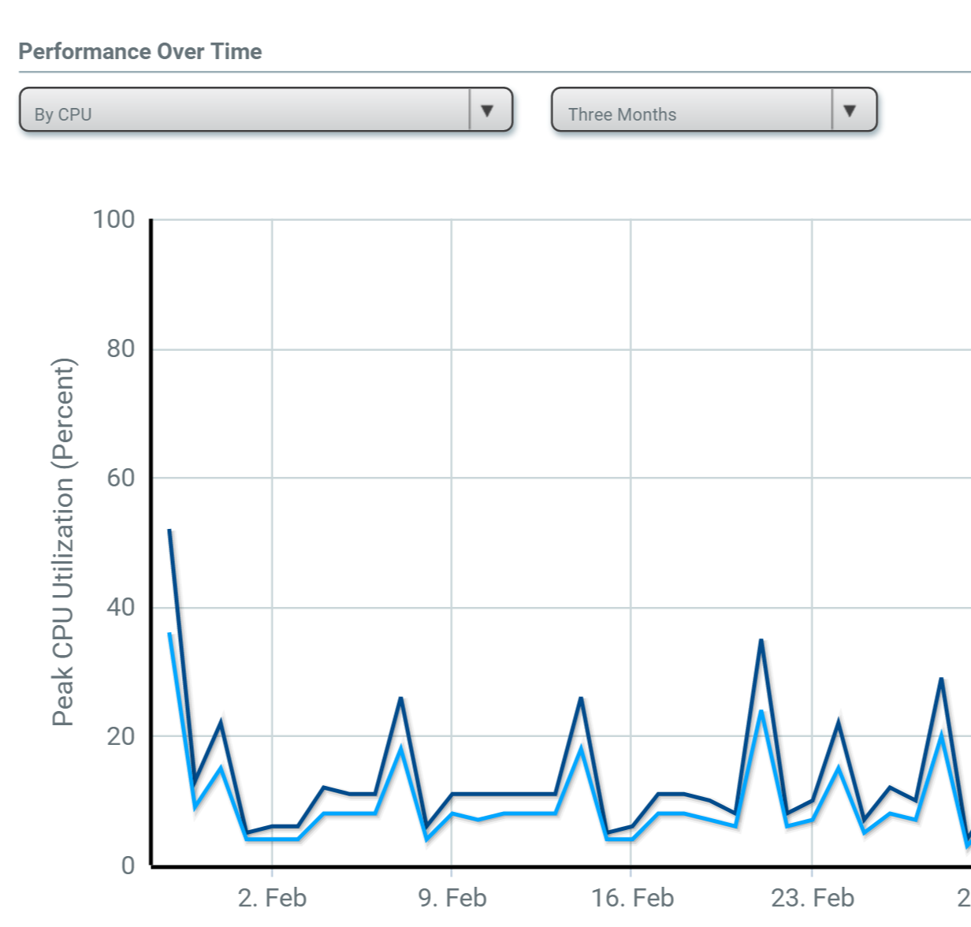
THE CLOUD JOURNEY
Assess
Get precise TCO for Azure
Identify your best fit configuration
See projected performance with recommended cloud configuration

Slide 3
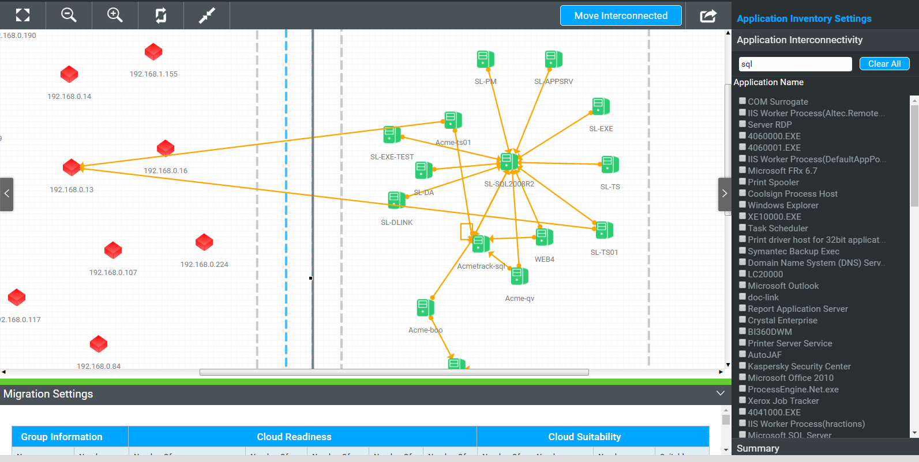
THE CLOUD JOURNEY
Plan
Discover your infrastructure
Map application dependencies
Build move groups and design your migration plan
Identify optimal cloud configuration for each workload to migrate to

Slide 4
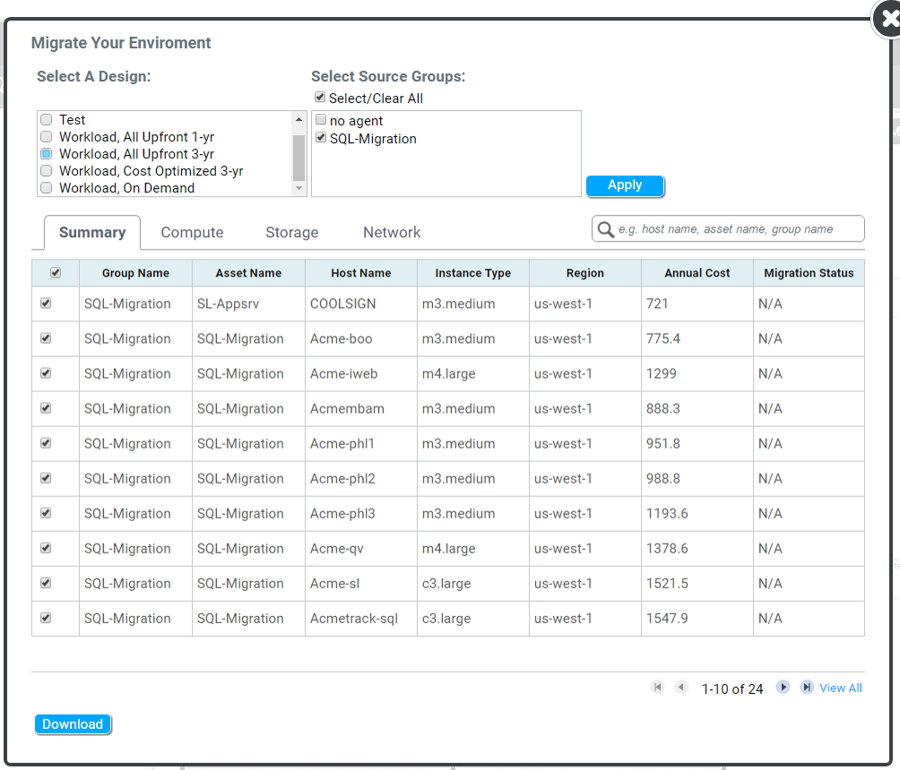
THE CLOUD JOURNEY
Migrate
Import your migration plan to ASR
View ASR Readiness Reports
Migrate workloads to Azure

Slide 5
THE CLOUD JOURNEY
Validate
Visualize connectivity between infrastructures
Compare new state to historical state
Validate application dependency

Slide 6
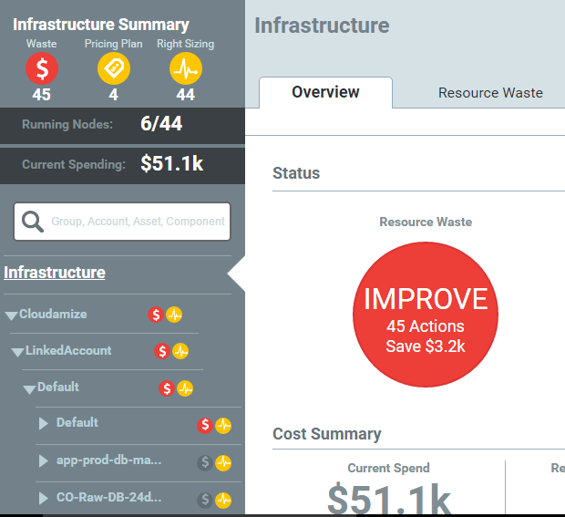
THE CLOUD JOURNEY
Manage
Right-size cloud workloads
Accurately plan capacity
Analyze costs, filter billing data, and build chargebacks

Slide 7
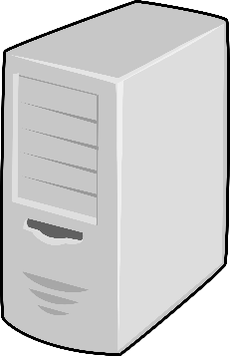
Cloudamize Agents Data Flow
Firewall
VPN 1
Physical Machine
Virtual Machine
Outbound 80 or 8080 / 443 (TLS 1.2)
Outbound 443 (TLS 1.2)
VPN 2
Corporate Proxy
Cloudamize Server
Physical Machine
Virtual Machine

Slide 8

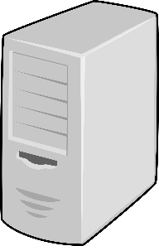
Cloudamize Agent-less Data Flow
Firewall
Subnet 1
Outbound 80 or 8080 / 443 (TLS 1.2)
Inbound SSH / WMI
Physical Machine
Virtual Machine
Cloudamize Agentless Data Collector 1
Outbound 443 (TLS 1.2)
Subnet 2
Corporate Proxy
Inbound SSH / WMI
Cloudamize Server
Physical Machine
Virtual Machine
Outbound 80 or 8080 / 443 (TLS 1.2)
Cloudamize Agentless Data Collector 2

Slide 9
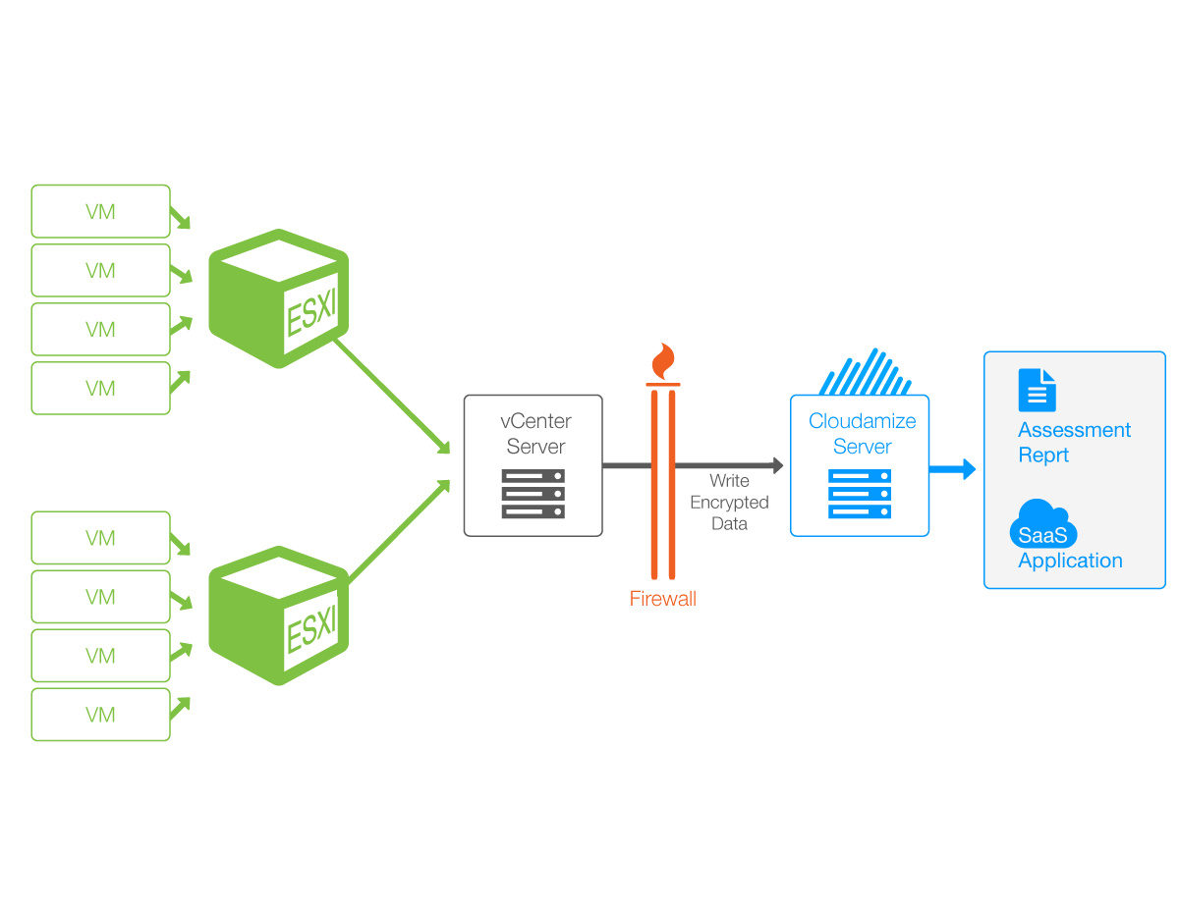
vCenter FAQ
Read-only credentials must be created for each vCenter
Data travels via Cloudamize Proxy which can be installed either directly on the vCenter machine or different VM
The Cloudamize Proxy is unique to each vCenter
The proxy communicates on 443 to IP 184.73.183.154

Slide 10
Agent-less vs Agent-based
Class | Agent-based | Agent-less
Data Collection Method | Light-weight software on each end-point | SSH, WMI
Security Protection | Traffic is encrypted via SSL between endpoints and the Cloudamize server with mutual end-point authentication. | Ports will be open between the agent-less data collector and all endpoints on the subnet. Data is sent from the collector to the Cloudamize servers and is encrypted via SSL.
Deployment Model | Agents must be installed on physical and virtual machines as well as Hyper-V hosts. The agent can easily be pushed out via Active Directory, chef, puppet, SCCM, etc. | WMI services for each Windows endpoint and SSH will need to be configured for each Linux endpoint. One machine/VM will need to have the agentless data collector installed.
Ease of Deployment | A single outbound port (TCP 443) to a 104.197.11.97 is required. Generally this port is already open and no changes are needed. | Agentless Data collector installed locally on one machine per subnet. Ports 135, 445, and 1024-65535 will need to be open inbound on all Windows endpoints, and open outbound on the machine with the data collector installed. Port 22 will need to be open inbound on all Linux endpoints. The machine with the data collector installed will communicate outbound on 443 to Cloudamize IP 184.73.183.154.
Resource Consumption | Data collection occurs locally and compressed data is sent over the internet. Data collection is halted if CPU and memory thresholds are crossed. For example, CPU is throttled at 2%. | Increases network traffic as the raw performance data is transported over the network to a remote data collector. No throttling mechanism available on the end points.
Accuracy | High frequency collection of performance metrics. Discovers all applications and their dependencies in detail. | Lower frequency data collection results in less accuracy and not all application dependencies are captured.
Scalability | Agent handles process initiation and stream handling making this very easy to scale. | Server must handle process initiation and stream handling resulting in a limit to how many connections can be handled concurrently. Agent-less Data collector can handle 500 endpoints per collector.
Robustness | Caching mechanism is available in the event of network disruption for added robustness. | Network connectivity issues can impact data collection.

Slide 11
Missing Features in Agent-less Approach
Metric | Impact
Short-lived connections | If the connections short-lived they are not captured and that may result in missed inter-connectivity
Lower performance resolutions | Monitoring window is at every 5 min rather than every 30-seconds. Likely to loose short-term peaks
DNS traffic and analysis | Mapping between IP address and DNS is not available
Installed list of applications | List of installed applications and their CPU Usage will not be collected
SQL Server Editions | Cost analysis will not include SQL Server editions and mapping
.NET version | Limited ASR compatibility analysis
Performance Throttling | Agentless-monitoring does not have performance controlling mechanism on the monitored host

Slide 12
Supported Systems
Supported Window OSs
Windows Server 2016
Windows Server 2012 R2
Windows Server 2012
Windows Server 2008 R2
Windows Server 2008
Windows Server 2003 R2
Windows Server 2003
Supported Linux OSs
Red Hat Enterprise Linux Server release 5.0 or higher
Ubuntu 10.04 or higher
CentOS release 5 or higher
Debian GNU/Linux 6.0 or higher
Amazon Linux AMI release 2013.03 or higher
Fedora release 12 or higher
Suse Linux 11 or higher
Oracle Linux 6.5 or higher
Chipsets
Intel Xeon
AMD Opteron
Pentium 4
Pentium D
Pentium M
Some Intel Core 2
*Typically desktop and laptop processors are not supported since they are not considered candidates to move to the cloud.

Slide 13
Deploy Cloudamize vs Manual approach
Manual approach
Generally start w/ incomplete CMDB
Have to fill in gaps w/ interviews
Create pivot tables and Vizio diagrams to make sense of and visualize data
Time and resource intensive for both partners and clients (can take months)
High likelihood of inaccuracies
Cloudamize
In most cases, no changes to firewall policy is needed so no issues with security change policy there.
Business policies of software (agent) change management is applied so it can take up to a week to install everywhere.
Quicker due to having all the necessary metrics at your finger tips
User interface enables building move groups based on specific criteria and TCO of that group enabling faster migration roadmap

Slide 14
Agent Installation: vCenter

Slide 15
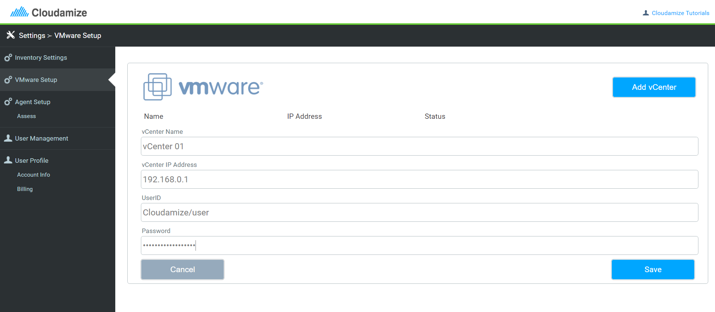
Add vCenter
Create read-only credentials for Cloudamize application. View the Cloudamize Tutorial here.

Slide 16
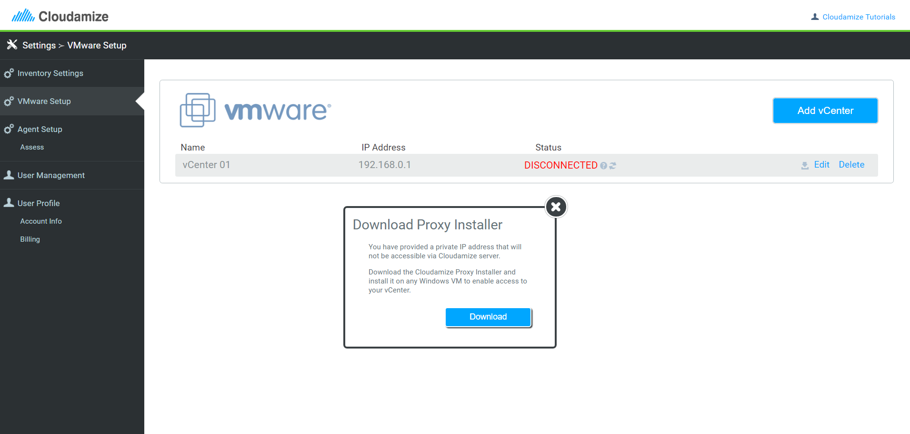
Install vCenter Proxy
Cloudamize Proxy will need to be installed on a Windows VM to route the traffic to Cloudamize Server.
View the Cloudamize Tutorial here.

Slide 17
How Does the vCenter Proxy Work?
Windows VM
or
vCenter NM
Cloudamize Proxy
Cloudamize
Server
SSL Port 443
SSL Port 443
The proxy can be installed either directly on the vCenter machine or on a separate Windows virtual machine.
The proxy is unique per vCenter and VM, if you have two vCenters, you will need two unique proxies installed
View the Cloudamize tutorial here.

Slide 18
Agent Installation: HyperV / Windows

Slide 19
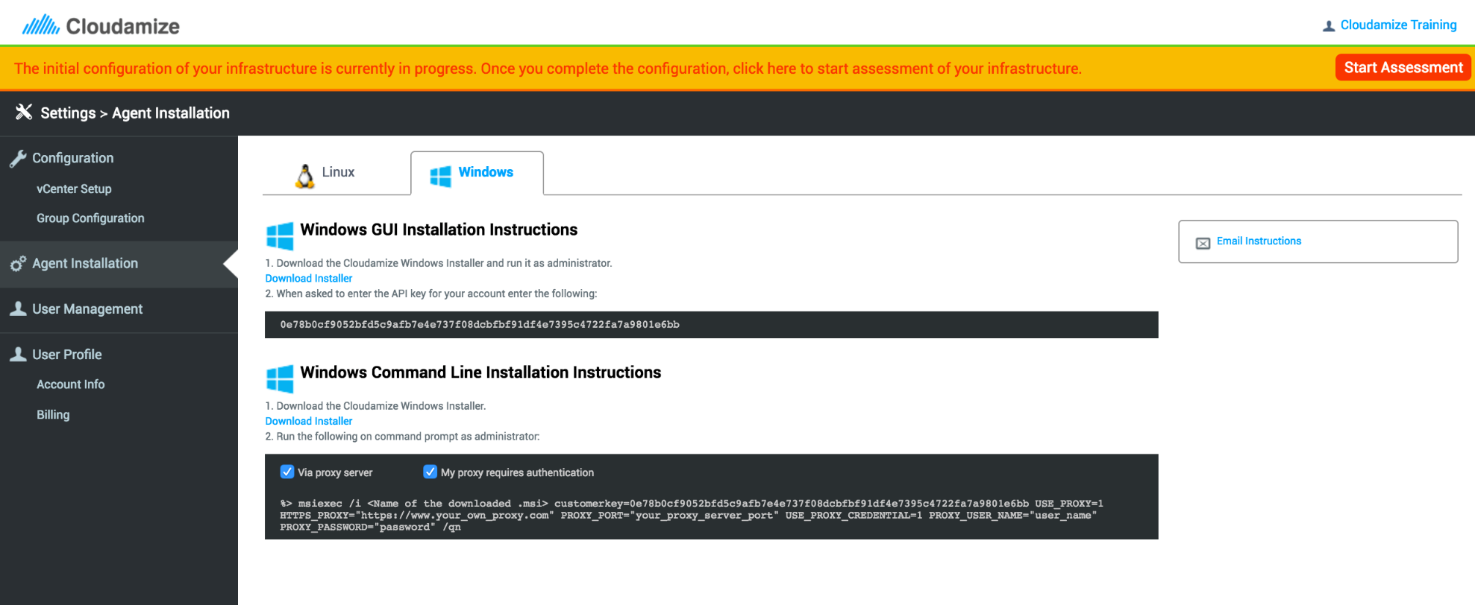
Add HyperV/Windows Agent
Export your customer key and install an agent
Outbound firewall over SSL/443 port
Data can be routed via internet proxy
View the Cloudamize Tutorial here.

Slide 20
Agent Installation: Linux

Slide 21
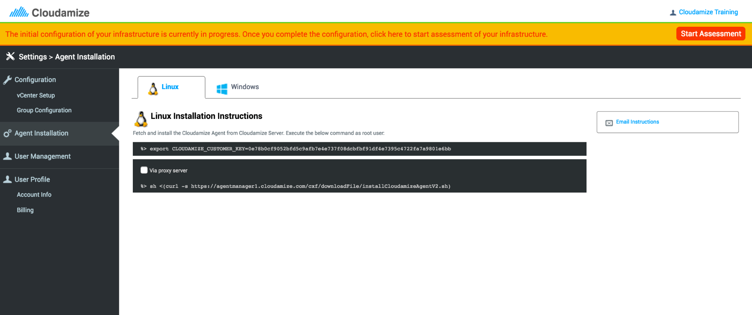
Add Linux Agent
Export your customer key and install an agent
Outbound firewall over SSL/443 port
Data can be routed via internet proxy
View the Cloudamize tutorial here.

Slide 22
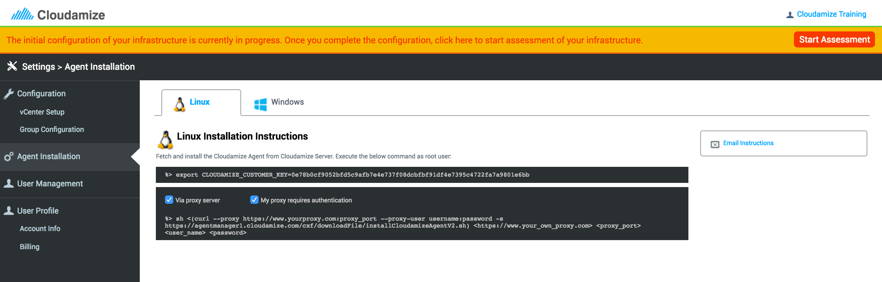
Route Agent Traffic via Internet Proxy
View the Cloudamize Tutorial here.

Slide 23
Agentless Installation

Slide 24
Minimum Hardware Requirements for Agentless Collector (up to 500 hosts)
64 bit OS
.NET 4.0
4 CPU Cores
5GB RAM
2GB HDD

Slide 25
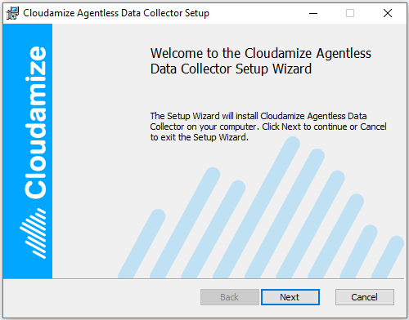
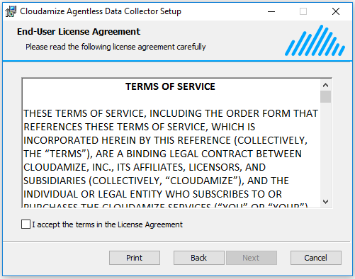
Cloudamize Agentless Data Collector: Setup

Slide 26
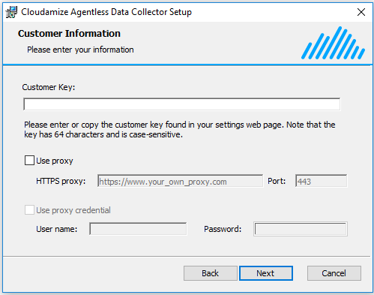
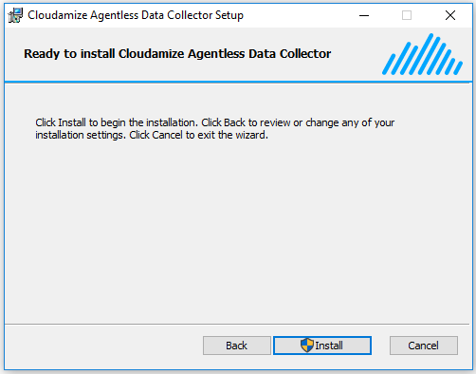
Cloudamize Agentless Data Collector: Setup

Slide 27
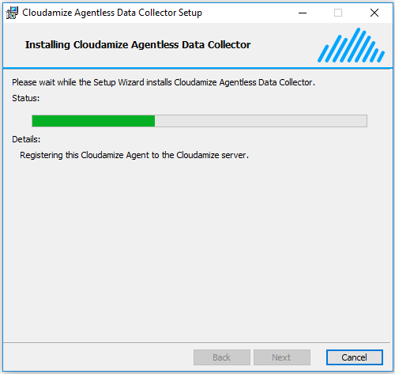
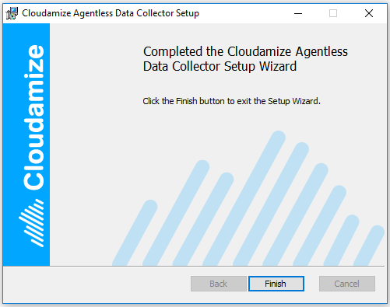
Cloudamize Agentless Data Collector: Setup

Slide 28
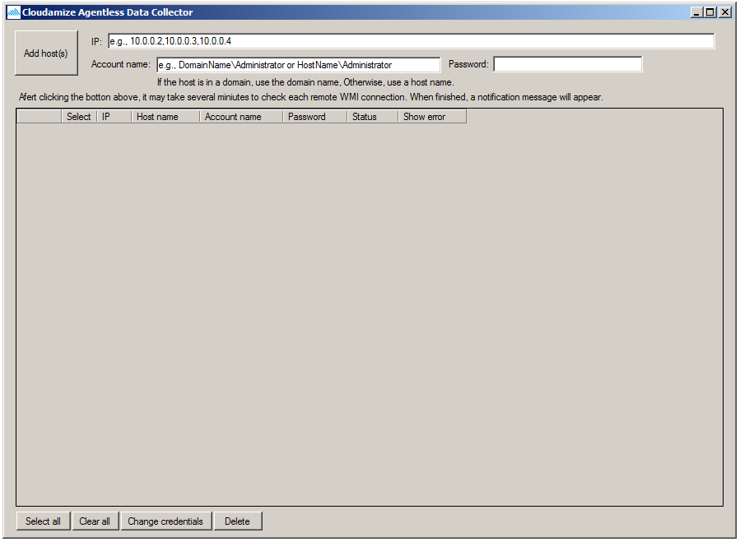
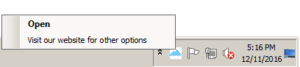
Cloudamize Agentless Data Collector: Launch
Launch Cloudamize Agentless Data Collector
Cloudamize Agentless Data Collector UI
2. Click to open Cloudamize Portal
1. Right click or double click on the tray icon to open UI

Slide 29
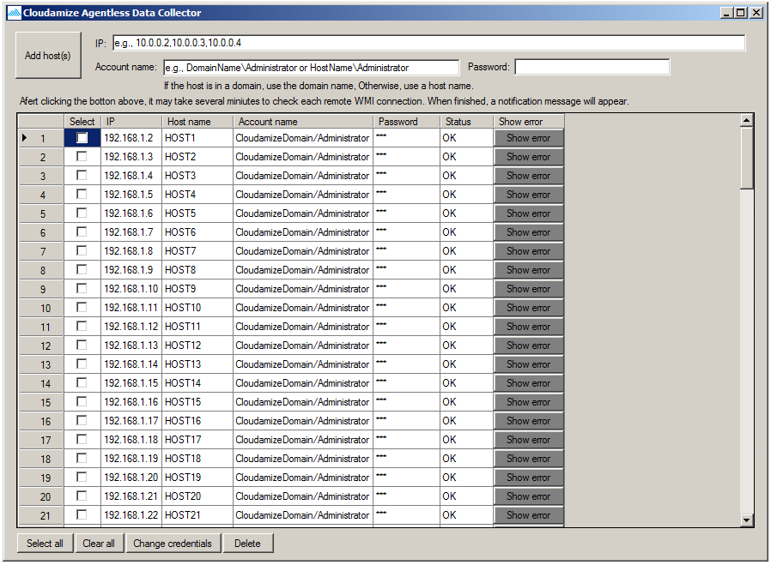
Configure Agentless Data Collection
1. Add Hosts
2. Select a host
3. Change credentials

Slide 30
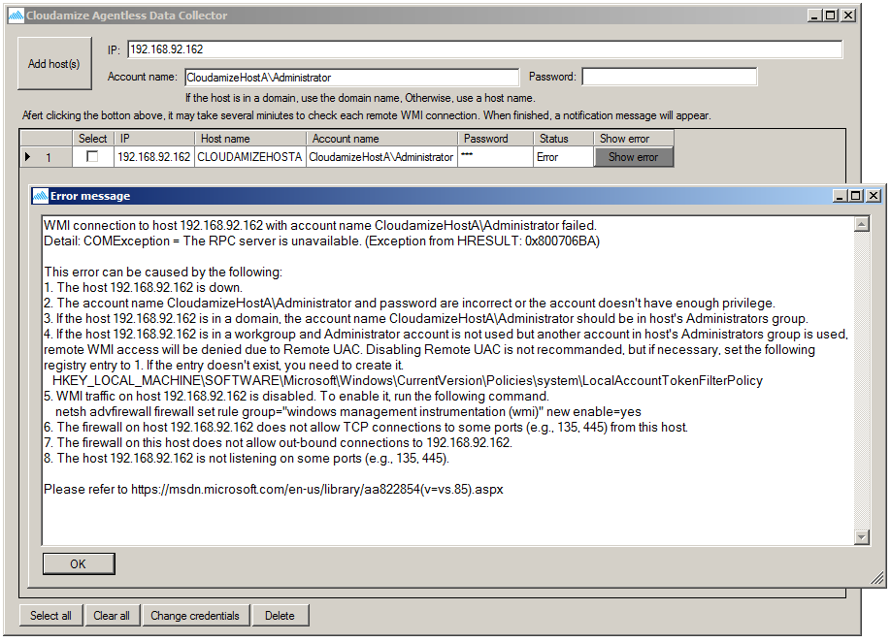
Identify Errors and Expedite Setup
Click this button to see an error message
Note that if a remote WMI connection fails after clicking ‘Add host(s)’ button or when changing credentials, this message will be popped up. This will allow customers to quickly debug infrastructure issues and commence data collection.

Slide 31
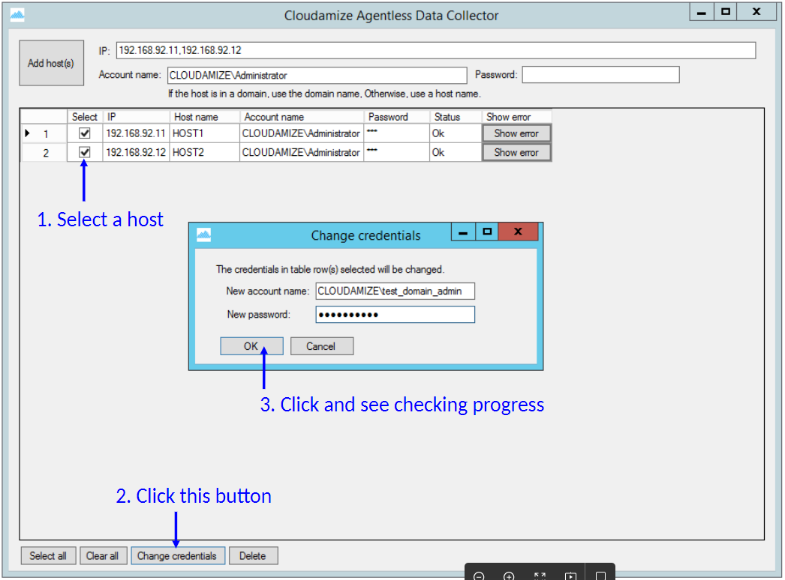
Change Credentials

Slide 32
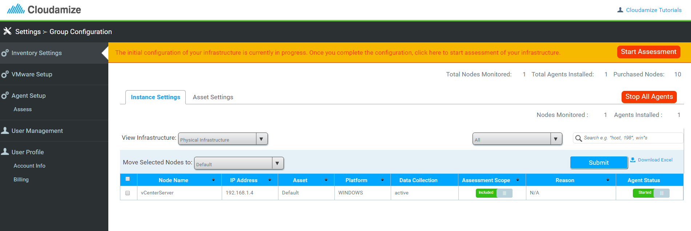
Start Assessment
Click here once ready to begin the assessment.
Check each view to ensure infrastructure is setup correctly.
Include all of the nodes that are desired for the assessment and exclude everything else.

Slide 33
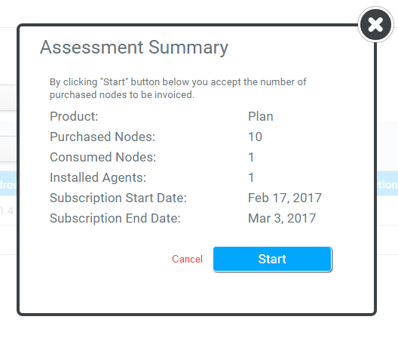
Confirm Assessment Summary
Review and confirm your assessment details before continuing.
Click “Start” to continue.
Option to cancel and return to configuration settings.

Slide 34
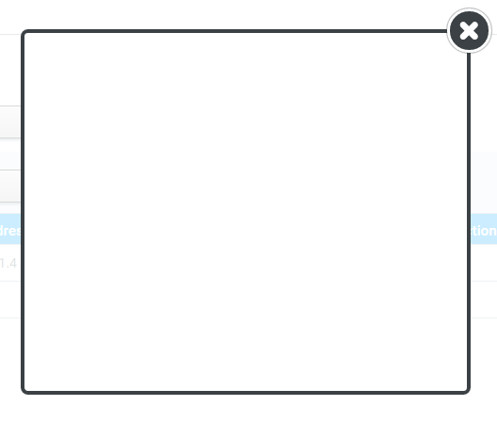
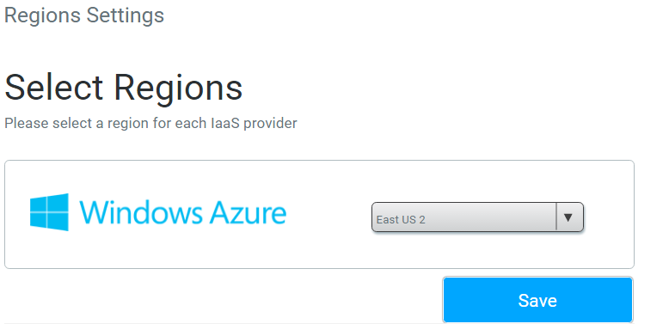
User Region Selection
Select Region that the assessment will be mapped to.
Click save to start the assessment

Slide 35
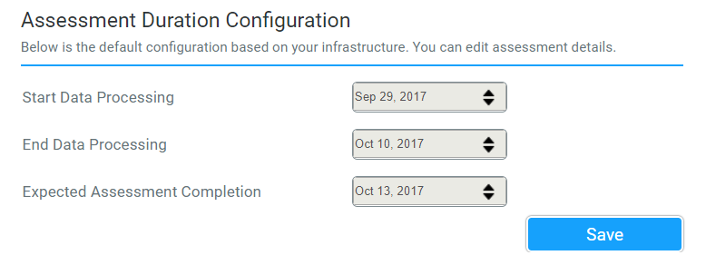
Select Assessment Dates / Duration

Slide 36
Review Cloudamize Results
Understand Cloudamize Results
Infrastructure mapping
Right-sizing recommendations
Cost analysis and TCO
Application dependencies
Application complexity
Move groups
ASR readiness analysis

Slide 37
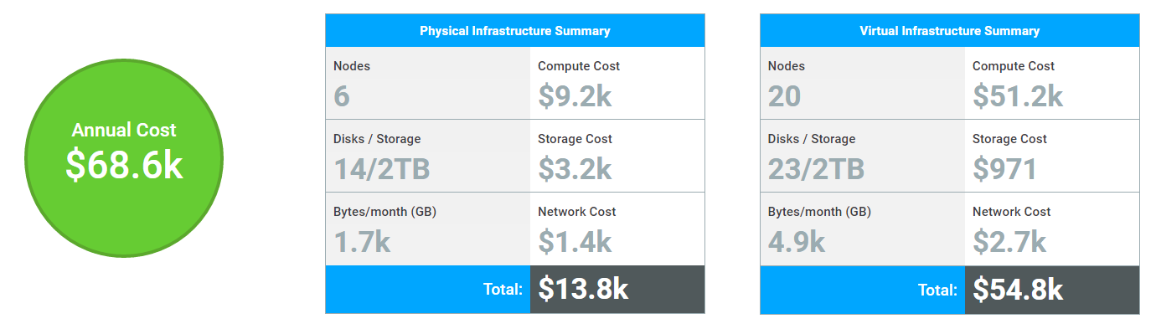
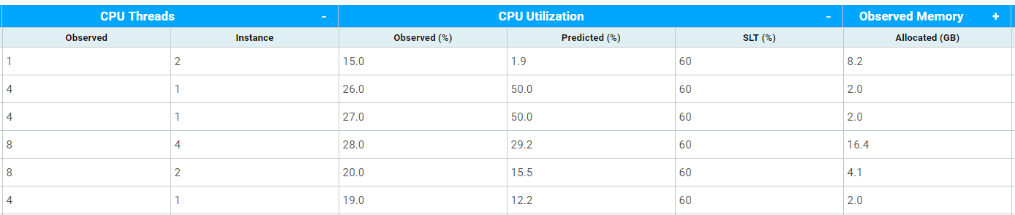
Price and usage breakdown for physical and virtual infrastructure
Cost Analysis, TCO & Right-Sizing
View data observed from your current infrastructure next to the related data from the recommended instance

Slide 38
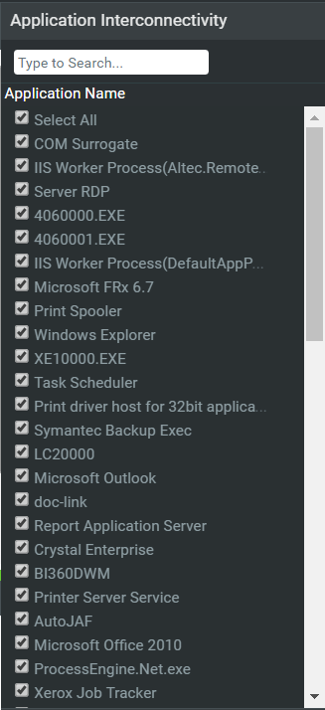
Application Dependencies and complexity
Visualize application interconnectivity between nodes.
View all applications running in your infrastructure and select applications to view interconnectivity.

Slide 39
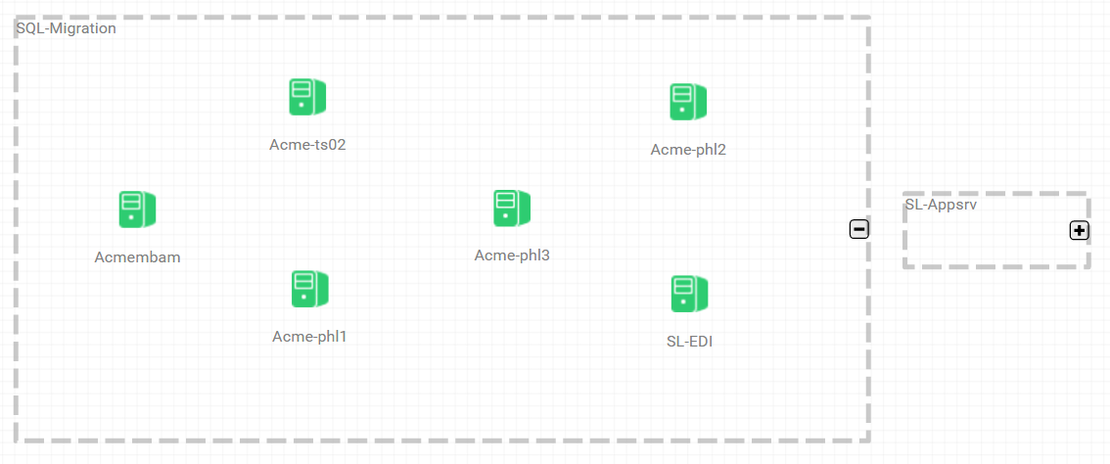
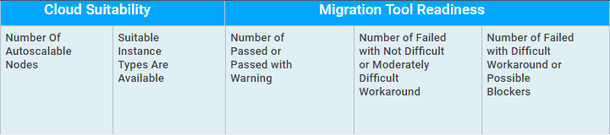
Move Groups & ASR Readiness Analysis
Create move groups, expand and collapse groups, and visualize the migration
Easily view which nodes and move groups are ready for migration

Slide 40
Build Initial Plan
Review results and initial pass of migration plan based on your knowledge of client environment
Revising plan generally includes:
Apply business drivers learned from initial scoping session
Reconcile dependencies based on earlier discussions
Editing configuration, deep dive into specific applications
Building move groups based on discussions using cost, hardware or time as a driver

Slide 41

ASR Readiness Analysis
Find optimal ASR targets by performing ASR compatibility checks
On-Premise Move Group
Azure Instances
SUCCESS
ASR Readiness Checks
WARNING
CRITICAL

Slide 42
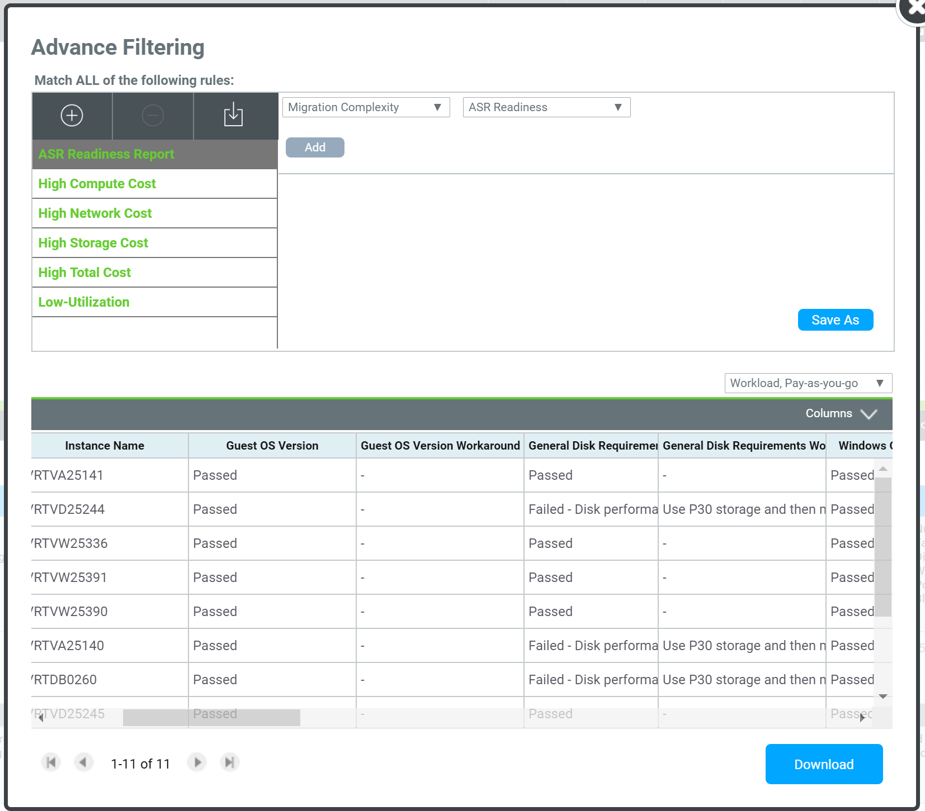
ASR Readiness Report
Validation against ~20 checks to see if the target is ready for ASR migration and divides outcome into Success/Warning/Critical.
Provides workaround for the machines that are identified with “Warning”
Example checks:
General Disk Requirements
Windows OS Requirements
Hypervisor Requirements
Disk Space Requirements
.NET Version Requirements
Boot Software Requirements
Linux System Requirements
Disk’s performance requirement failed but can be achieved by striping data across several disks.
Work around: Use P30 and migrate to RAID 0 after migration
Download detailed analysis

Slide 43
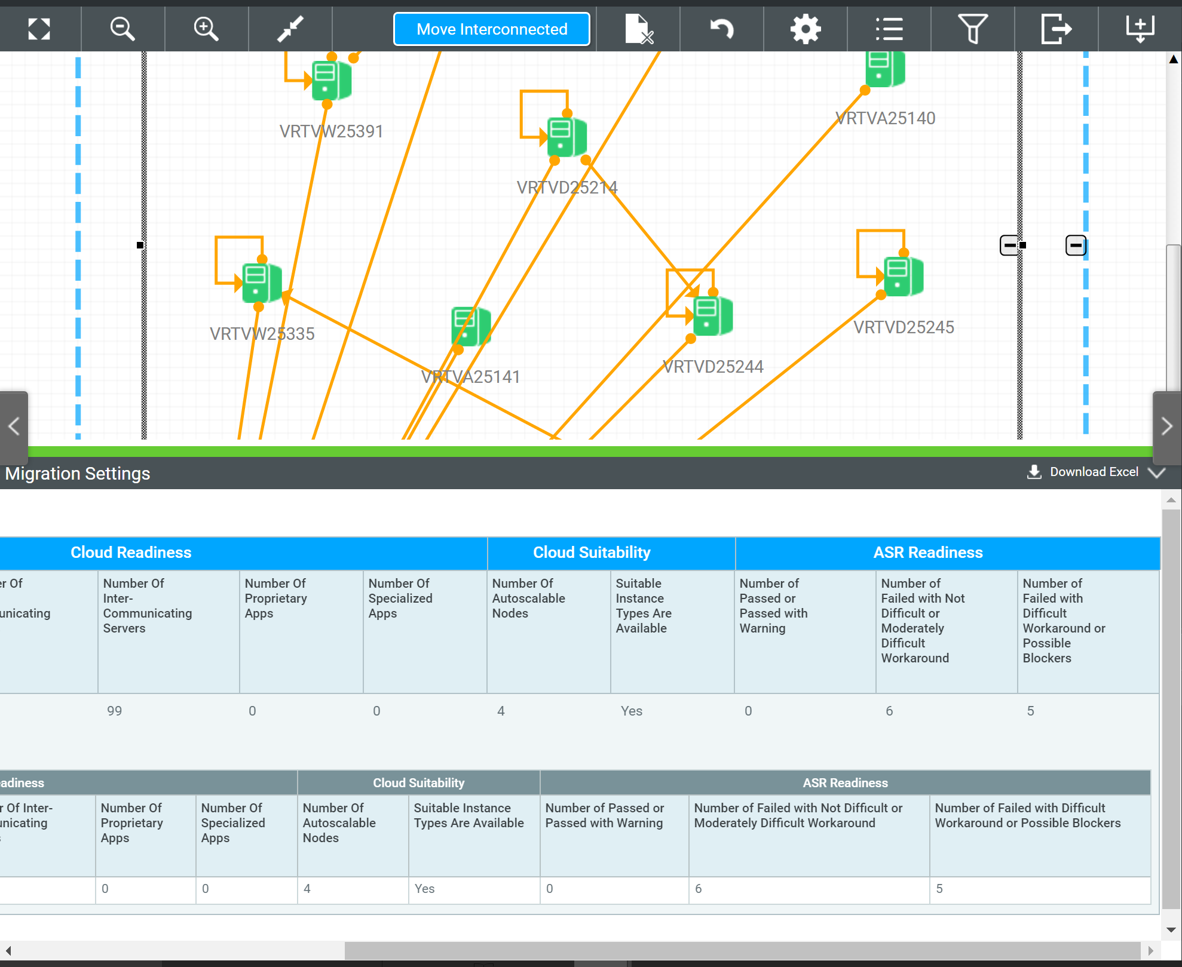
ASR Readiness by Move Group
Use ASR Readiness in prioritizing move groups.
Machines with “SUCCESS” – Migrate them first.
Machines with “WARNING” - Use recommended workaround to fix issue and complete migration to Azure.
View the Cloudamize Tutorial here.
SUCCESS
WARNING
CRITICAL

Slide 44
Steps to Migrate with ASR
Setup Configuration Server
Prepare to Migrate
Migrate
Select a Cloudamize design and a set of move groups
Select a machine to setup as the Configuration Server
Enter the Subscription ID and Resource Group for the Configuration Server
Select the machines to be migrated
Create new configurations or choose existing storage, network, and subnet configurations
Perform migration testing on the configured machines
Execute the migration

